Slide 1

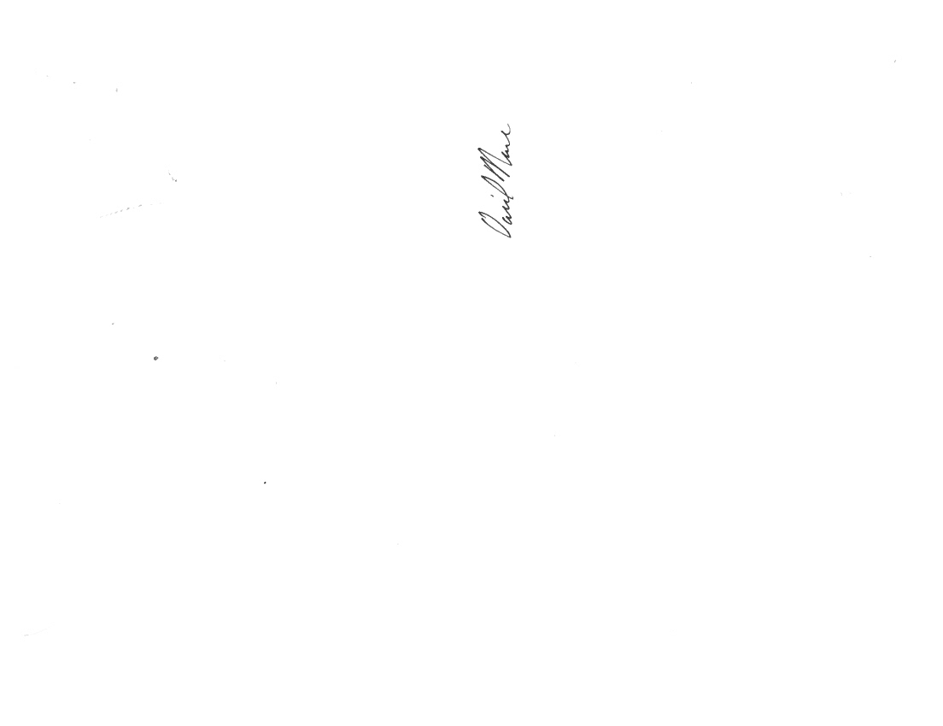
789 North Dixboro Road, Ann Arbor, Michigan 48105
(888) NSF-9000
Certificate of Approval
Is evidence that
Link Engineering Company – Chemical Laboratory
401 Southfield Road
Dearborn, MI 48120, USA
Has been assessed by NSF and found to be in conformance to the
Friction Material Program (FMP-LAB)
Scope of Registration:
FMP approved lab for testing to:
SAE J2975:2011*
SAE J2975:2013*
*Using EPA Method 3051A and EPA Method 6010C to evaluate mercury content instead of EPA Method 7471B/EPA Method 245.5.
Certificate Number: C0145907-AL007
Certification Issue Date: 12/02/2025
Registration Date: 10/24/2025
Expiration Date: 10/21/2026
This certificate is the property of NSF and must be returned upon request.
To verify approval call (888) NSF-9000 or visit our web site at www.nsf.org.
David Nance
Senior Manager, Water Systems

